Slide 1

Adgile media

Slide 2





1
2
3
WHY ADGILE MEDIA?
REAL-TIME TV INTELLIGENCE
BESPOKE DATA
INTEGRATIONS
+
+
+
4
5
SCALABLE
BENEFITS
HOW IT
WORKS
+
+
MENU

Slide 3
adgile
1
WHY ADGILE MEDIA?

Slide 4


WE HAVE BEEN FLYING BLIND!
DATA LAG
THE
PROBLEM
ZERO COMPETITOR CONTEXT
With over 65% of ATL media invested into TV…
…WHY is there still NO way to optimise this investment in terms of a measureable business value?
OUTDATED MEASUREMENT
REACH NOT REVENUE
*Source: SMI

Slide 5

...UNTIL
NOW

Slide 6

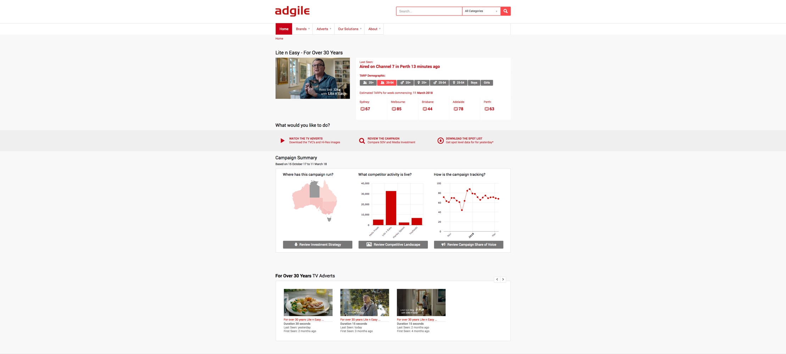
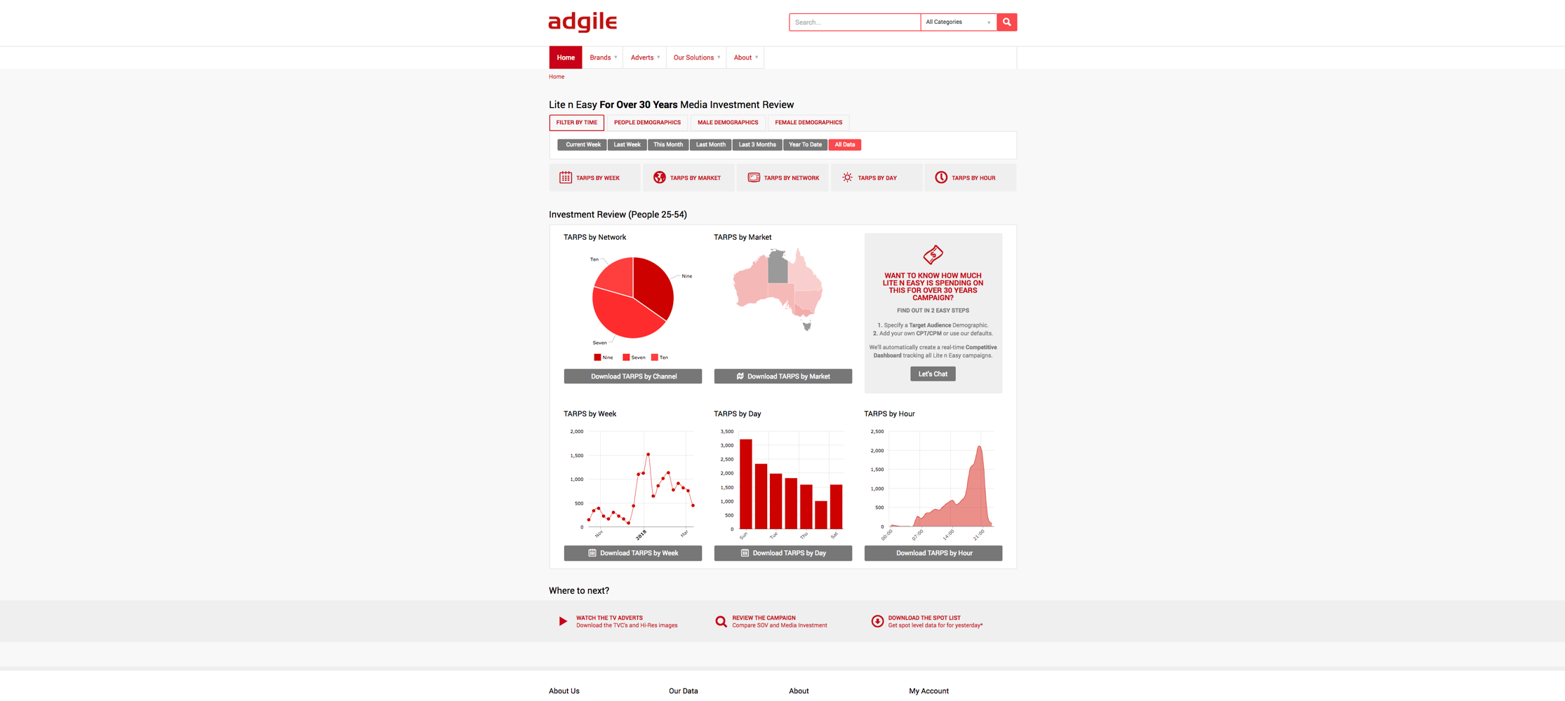

THE
SOLUTION
OBSERVE
VALIDATE
VALIDATE
A marketing automation platform that delivers Television data in real time.
Brands can now observe, validate, optimise and measure the channel that commands the greatest consumer attention and largest client investment...
…in real time.
OBSERVE
MEASURE
OPTIMISE

Slide 7


REAL-TIME MARKETING
AUTOMATION PLATFORM
Adgile’s technology literally watches TV.
Through machine learning it understands, collects and tracks every advert on air in real time.

Slide 8

BRAND RECOGNITION ALGORITHMS
Prediction algorithms identify the advertising Brand from a database of over 6,700.
Identification takes less than 10ms.

Slide 9

HIGH RESOLUTION ADVERT IMAGE RECOGNITION
High resolution image recognition identifies adverts whilst they are being broadcast.
A four-stage multi-layered validation process ensures accuracy and differentiation between offers & products.
Adgile monitors 1million data points per second for each TV Channel broadcast (>150 broadcast signals across Australia)

Slide 10







We sample over ~250,000 data points per frame
4 frames per second
Every channel in Australia
79 Metro channels
7 Regional markets
22 STV channels
AT SCALE –
FASTER THAN A HUMAN BRAIN
To monitor and track ~6,700 brands (and growing)
Over 70,000 adverts (and growing)
In real-time, 24 hours a day, 7 days a week
All of this happens in less than 10ms, which is the speed of processing in the human visual system.
Source: Thorpe SJ, et al (1996)

Slide 11

ADGILE MEDIA WILL ALLOW YOU TO KNOW, DO AND BE…
MORE

Slide 12




Slide 13
BE MORE INFORMED
Don’t just track your competitor campaigns – understand total competitive context. Interrogate their tactics, understand their strategy, and pre-empt their next move.
IN REAL TIME

Slide 14
BE MORE INFORMED
BE MORE RELEVANT
Don’t just track your competitor campaigns – understand total competitive context. Interrogate their tactics, understand their strategy, and pre-empt their next move.
You’ve spent a lot of time and effort on engaging your audience, but that’s not enough anymore. You can now master the timing and seize their attention in the moment.
IN REAL TIME
IN REAL TIME

Slide 15
BE MORE INFORMED
BE MORE RELEVANT
BE MORE EFFICIENT
Don’t just track your competitor campaigns – understand total competitive context. Interrogate their tactics, understand their strategy, and pre-empt their next move.
Identify campaign inefficiencies in real-time. Spot opportunities and optimise your schedule to be more effective in converting immediate purchase and building brand equity.
You’ve spent a lot of time and effort on engaging your audience, but that’s not enough anymore. You can now master the timing and seize their attention in the moment.
IN REAL TIME
IN REAL TIME
IN REAL TIME

Slide 16
adgile
2
REAL-TIME TV INTELLIGENCE

Slide 17





ADGILE MEDIA GIVES YOU
100% VISIBILITY
Channels
Viewers
Brands
Insights
Responsive

Slide 18



EVERY TV CHANNEL COVERED

Slide 19

AND WE MONITOR THEM ALL IN REAL TIME
REGIONAL QLD
1.8m
TOTAL GEOGRAPHIC COVERAGE
REGIONAL WA
560k
17 million metro viewers
61% of Australia’s TV viewers*
7.7 million additional regional viewers
35% of Australia’s TV viewers*
7.7 million STV viewers
15% of Australia’s TV viewers*
BRISBANE
3.3m
PERTH
2.1m
REGIONAL NSW
3.7m
SYDNEY
5.1m
ADELAIDE
1.4m
MELBOURNE
5.1m
REGIONAL VIC
1.2m
… plus ALL New Zealand viewers.
3.1 million viewers
100% of NZ TV viewers
NEW ZEALAND
3.1m
TASMANIA
524k
*Source: ozTAM / Regional TAM

Slide 20

EVERY
BRAND ADVERTISING
ON TV
EVERY
BRAND ADVERTISING
ON TV
* For an up to date list please visit our website

Slide 21





135
SECTORS
5,832
100
4,607
973
BRANDS
PRODUCTS ADDED
EVERY DAY
ADVERTISERS
CATEGORIES
18
1,857
INDUSTRIES
TYPES

Slide 22

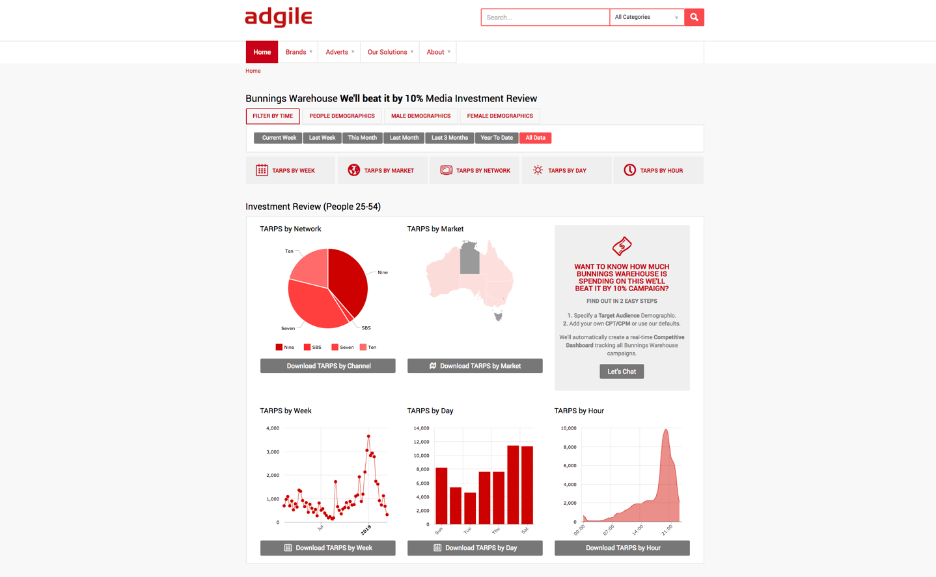
REAL-TIME COMPETITIVE INTELLIGENCE
Track and monitor any competitor campaign accessing insights through our real-time reporting.
Historical data is exportable to PDF, CSV, email or by ingesting our data directly into your current systems.

Slide 23
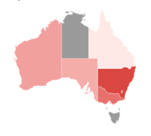
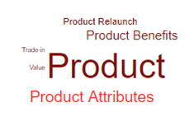
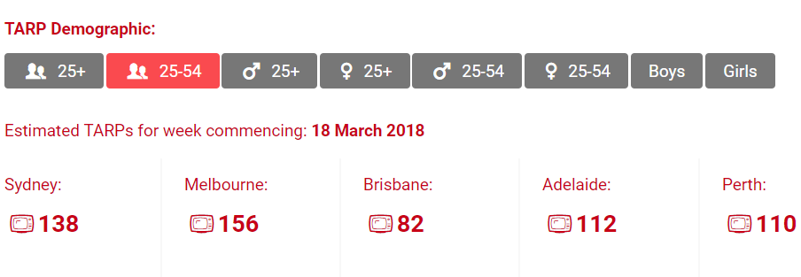
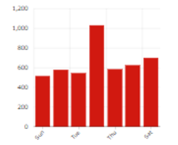
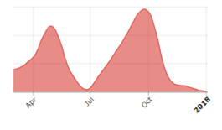
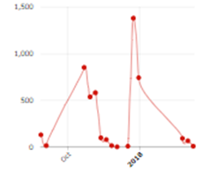
ANALYTICS
DASHBOARDS
REGIONS
We cover all TV Metro regions across Australia as well as all Regional TV markets.
DEMOGRAPHICS
We cover all major age and gender demographics.
REGIONS
We track all advert variations, all durations, and tag every advert with purpose and tactic.
Customisable, real-time dashboards that allow you to slice and dice data your way.
View all competitor activity, set benchmarks and then monitor in real time.
INVESTMENT INSIGHTS
We split out network share, dayparts and day of week data within standard dashboards.
SHARE OF SPEND
We can import group rate cards, CPM or CPT to give you a real-time view on current competitor and category market investment.
SHARE OF VOICE
Should you really spend the same amount when no competitors are active as when they all are? Real-time SOV gives you the power.

Slide 24

REAL-TIME TRACKING
Media optimisation, post analyse, measure and manage your TV media in real time and in more detail than ever before.
Track Network Sponsorship delivery or retail co-op brand and product appearance.
Identify new opportunities for gaining efficiencies and effectiveness.

Slide 25


REAL-TIME TRACKING
POST ANALYSE AND MONITOR MEDIA QUALITY IN REAL TIME
Spots with adjacent competitors
Advert breaks with competitors
Position in break/program
Post analyse TV in the moment. No delay for data and have copies of EVERY competitors ad on hand in real-time
BE AWARE AND NEGOTIATE WITH A STRONGER HAND

Slide 26
REAL-TIME TRACKING
POST ANALYSE AND MONITOR MEDIA QUALITY IN REAL TIME
Spots with adjacent competitors
Advert breaks with competitors
Position in break/program
Post analyse TV in the moment. No delay for data and have copies of EVERY competitors ad on hand in real-time
BE AWARE AND NEGOTIATE WITH A STRONGER HAND
MONITOR SPONSORSHIPS
Monitor in-program mentions
Ensure value delivery
Police competitor lock-outs
ENSURE MAXIMUM RETURN

Slide 27
REAL-TIME TRACKING
POST ANALYSE AND MONITOR MEDIA QUALITY IN REAL TIME
Spots with adjacent competitors
Advert breaks with competitors
Position in break/program
Post analyse TV in the moment. No delay for data and have copies of EVERY competitors ad on hand in real-time
BE AWARE AND NEGOTIATE WITH A STRONGER HAND
MONITOR LOGO LICENSING
Understand the value your brand partners are receiving from your credibility
MONITOR SPONSORSHIPS
Monitor in-program mentions
Ensure value delivery
Police competitor lock-outs
NEGOTIATE WITH A STRONGER HAND
ENSURE MAXIMUM RETURN

Slide 28
REAL-TIME TRACKING
POST ANALYSE AND MONITOR MEDIA QUALITY IN REAL TIME
Spots with adjacent competitors
Advert breaks with competitors
Position in break/program
Post analyse TV in the moment. No delay for data and have copies of EVERY competitors ad on hand in real-time
CO-OPS/PRODUCT PROMOS
Track brand airtime within co-op adverts and product promotions
GET THE FULL PICTURE
BE AWARE AND NEGOTIATE WITH A STRONGER HAND
MONITOR LOGO LICENSING
Understand the value your brand partners are receiving from your credibility
MONITOR SPONSORSHIPS
Monitor in-program mentions
Ensure value delivery
Police competitor lock-outs
NEGOTIATE WITH A STRONGER HAND
ENSURE MAXIMUM RETURN

Slide 29




TV
REFLEX
Adgile media enables brands to combine the strengths of TV and
Digital media to improve the effectiveness of advertising campaigns and increase the return on investment.
+
=
PERSUASIVE POWER
OF TV
PERSONALI-SATION OF DIGITAL
INCREASED ROI

Slide 30






REAL TIME
Activate while the advert is on air
For any specified period (adbreak, program)
Target the demographic watching TV
Target other demos to extend reach
MACRO MOMENTS
Target sporting events, cultural events, Target key programs (The BLOCK, Bachelorette etc.),
Target key retail events (Back to School, EOFY)
MICRO MOMENTS
Target a change in the weather
Target results of key events (Sports, X-Factor, The voice)
BRAND TARGETING
Target one or more brands
Target when retailers promote a brand
PRODUCT TARGETING
Target specific products
Target competitor ‘Sales’ or promotions
Target product launch or message type
Target when retailers promote a product
SHARE OF VOICE
Reflex based on SOV
Increase / Decrease bids or budget
PROGRAM CONTENT
Monitor program content for keywords
Target based on program genre
REMARKETING
Continue the sales process
Exclude existing customers

Slide 31




HOW DOES TV REFLEX WORK?
Content recognition technology listens and watches all TV channels 24/7.
Fingerprinting technology recognises TVC, TV show or keyword mention.
Instant API connection with media buying technologies automatically triggers a digital campaign within 3 seconds.
Deploy any ad format, in any digital channel, through any platform partner.
VIDEO
SOCIAL
DISPLAY

Slide 32



Digital campaign runs for a strategically specified duration.
ROI and competitor activity are measured by analysing reflex data.
Measure your website activity against TV spots in real time.
Adgile has real-time API integration with Google Analytics to measure the campaign contribution in context of competitor activity.
ADVERT ROI
COMPETITOR ACTIVITY

Slide 33
PLUS … SUBTITLE EVENTS
Melt the butter slowly until it’s frothy.
While the butter is melting,
pop a slice of wholewheat bread in the toaster.

Slide 34
adgile
3
BESPOKE DATA
INTEGRATIONS

Slide 35


BESPOKE DATA INTEGRATIONS
Give real context to your TV advertising effectiveness by understanding ALL of the variables that contribute to your TV advertising performance.
Seamlessly connect TV to your entire Marketing / Advertising stack.
BEST PRACTICE
API CONNECTORS
+
DYNAMIC REPORTING
Multiple API interfaces.
Custom integration team.
Securely integrate with your BI system of choice.
Online reporting.
White Label websites.
Data extracts to all common formats.
SEAMLESS
YOUR DATA, YOUR WAY

Slide 36
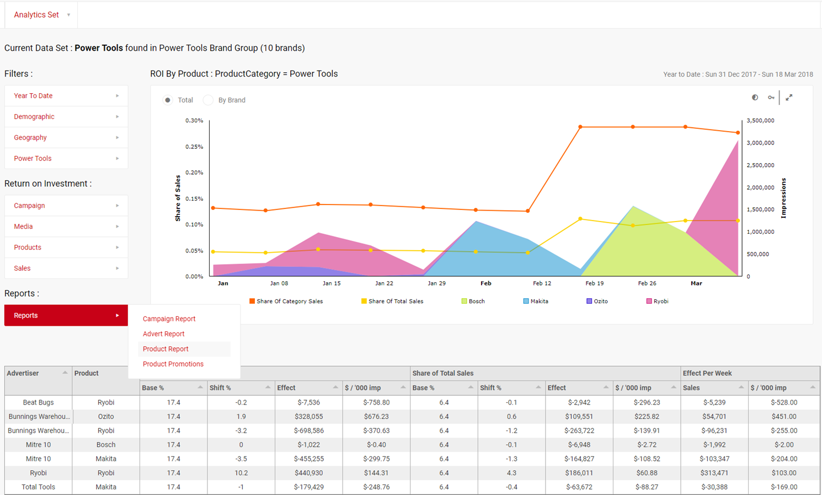
ADVANCED
ANALYTICS
Go well beyond traditional measurement metrics with a real-time lens at the most granular level.
Integrating actual sales, with of media, viewed with total competitive context is delivering REAL television ROI.

Slide 37
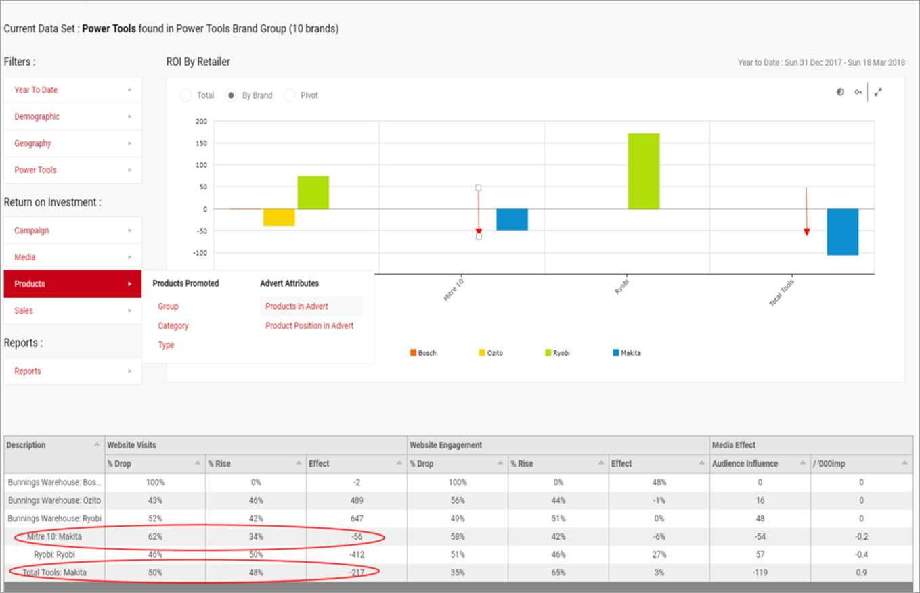
ADVANCED
ANALYTICS
You now have the ability to correlate competitor TVC activity with +/- web visitation to your site in real time.
Understand competitive activity and optimise your investment to deliver continually improve ROI.

Slide 38
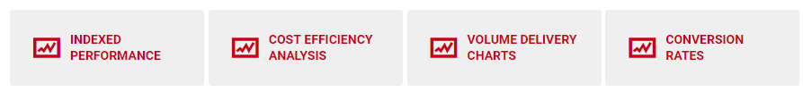
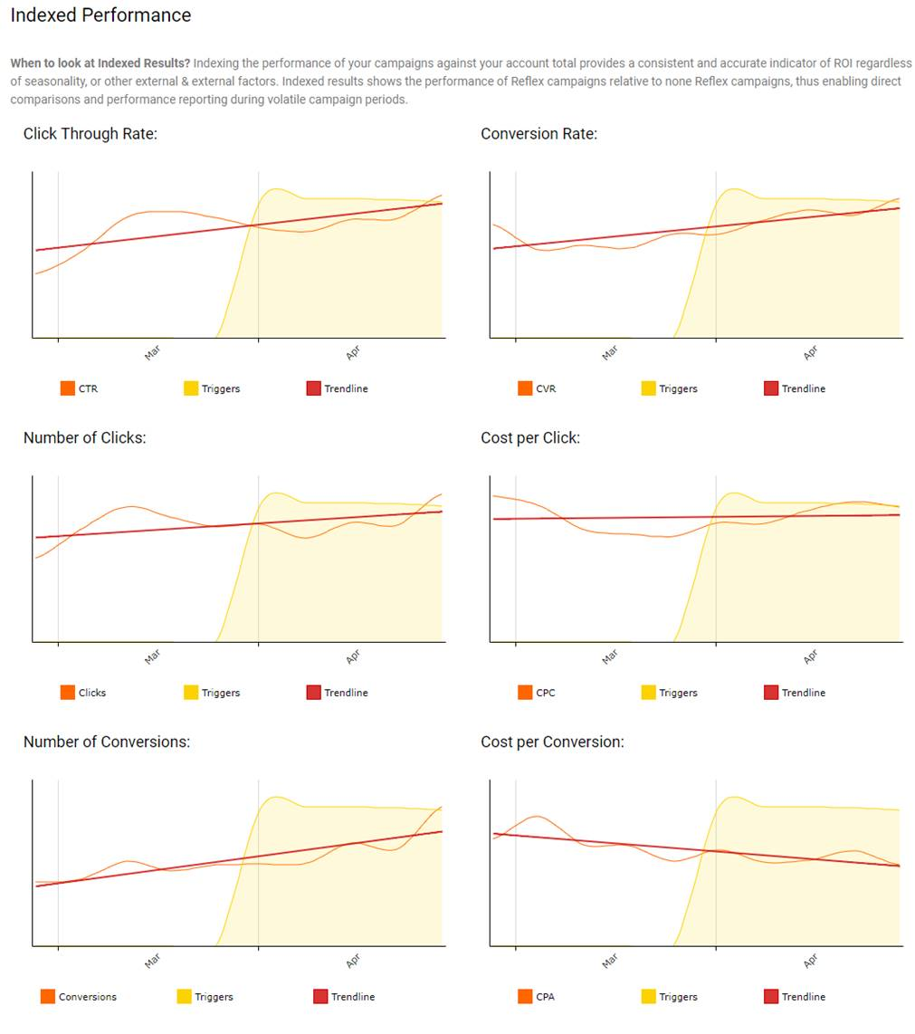
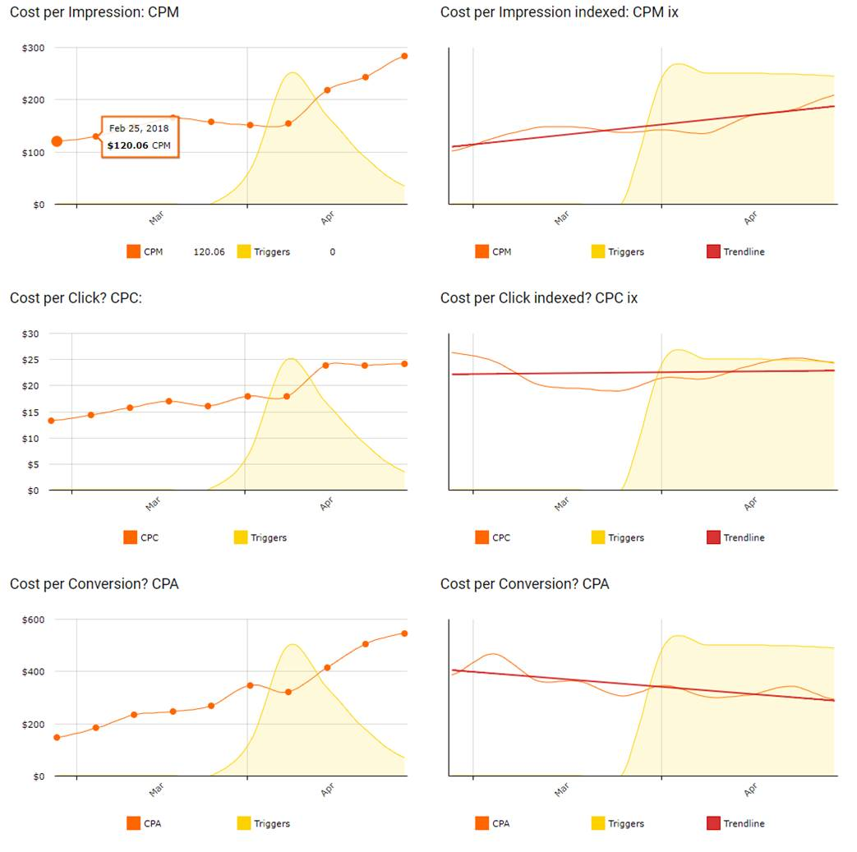
ADVANCED
ANALYTICS
Have all of your performance metrics automated in real-time with a single key stroke.

Slide 39
adgile
4
SCALABLE
BENEFITS

Slide 40





MEASURE
OBSERVE
THE ADGILE
SOLUTION
OUR
PROCESS
OPTIMISE
DISCOVER
A disciplined approach to deliver visibility, context, measurement and actionable insights.
All in real time.
VALIDATE

Slide 41
DATA INTEGRATION
Understand advertising impact from web visitation, right down to sales @ product/store level.
MEASURE
OBSERVE
THE ADGILE
SOLUTION
OPTIMISE
DISCOVER
TV REFLEX
VALIDATE
COMPETITIVE INTELLIGENCE
Amplify, conquest and leverage key Macro and Micro moments.
Total visibility on all competitor TV activity.
CONTENT TRACKING
Tracking all brand and product in-program sponsorship appearance. Tracking of all product placement within retail TVC.

Slide 42
COMPETITIVE INTELLIGENCE
MEASURE
OBSERVE
THE ADGILE
SOLUTION
THE RESULT
CONTENT TRACKING
MEDIA OPTMISATION
Deliver efficiencies across all of your TV and digital media investment.
And do it all in real time.
OPTIMISE
DISCOVER
VALIDATE
TV REFLEX
ACTIONABLE INSIGHTS
DATA INTEGRATION

Slide 43
adgile
5
HOW IT
WORKS

Slide 44

AUDIENCE MEASUREMENT
Customisable real-time audience measurement.
TARP translation.
Oztam/Nielsen compatible.
RELIABLE METRICS

Slide 45





REAL-TIME MARKETING
AUTOMATION PLATFORM
CONSISTENT
REAL TIME
ROBUST
COMPATIBLE
Consistency across mediums.
Able to be calculated and applied in real time.
Reliable and accurate across all advertisers and categories.
Compatible with traditional reporting methods.

Slide 46

THE TECHNOLOGY
Proprietary hardware and software developed across a 3 year period delivers ACTUAL real time, useable TV data.

Slide 47




DATA STREAMS CONTAINED IN TV BROADCASTS SIGNALS
1
2
3
VIDEO
AUDIO
SUBTITLES
Video provides high resolution images that enable real-time analysis.
Audio sampling is used to help identify between adverts
and TV.
Subtitles enable in program content targeting and analysis.

Slide 48
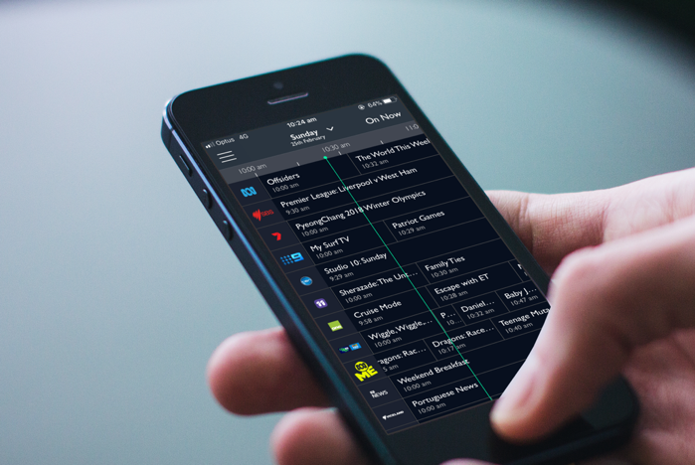
DATA STREAMS CONTAINED IN TV BROADCASTS SIGNALS
1
1
2
3
4
VIDEO
AUDIO
SUBTITLES
EPG
Video provides high resolution images that enable real-time analysis.
Audio sampling is used to help identify between adverts
and TV.
Subtitles enable in program content targeting and analysis.
EPG enables audience calculations and contextual alignment.

Slide 49
DATA STREAMS CONTAINED IN TV BROADCASTS SIGNALS
1
2
1
3
4
VIDEO
AUDIO
SUBTITLES
EPG
Video provides high resolution images that enable real-time analysis.
Audio sampling is used to help identify between adverts
and TV.
Subtitles enable in program content targeting and analysis.
EPG enables audience calculations and contextual alignment.

Slide 50
DATA STREAMS CONTAINED IN TV BROADCASTS SIGNALS
2
3
1
4
AUDIO
SUBTITLES
EPG
Audio sampling is used to help identify between adverts
and TV.
Subtitles enable in program content targeting and analysis.
EPG enables audience calculations and contextual alignment.

Slide 51

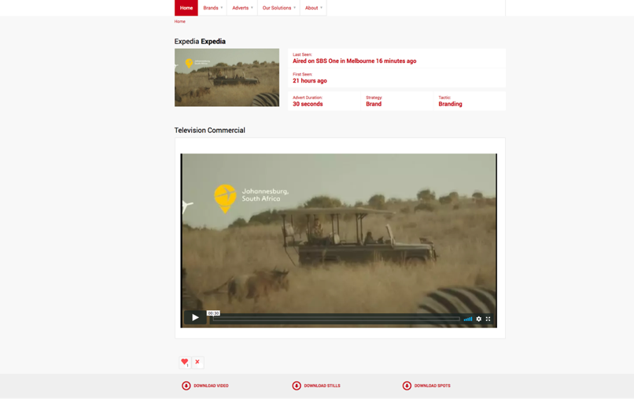
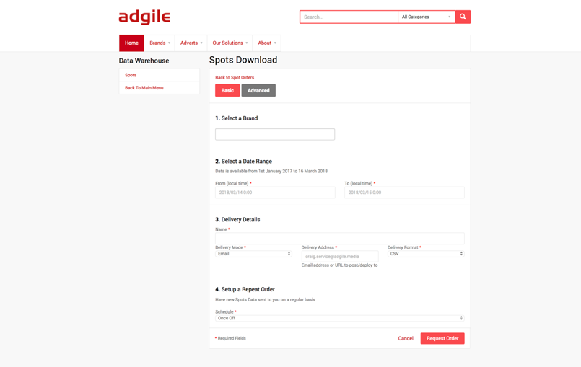








100% TRANSPARENCY GUARANTEED
Actual TV images viewable in sequence of visible frames.
FULL spot lists downloadable and trackable against confirmed schedule, station logs and Nielsen post data.

Slide 52

ADGILE TECHNOLOGY STACK
Microsoft Technologies
Microsoft
Azure Cloud
Unified Application Model
Service Bus Infrastructure
Self Learning Network
Distributed Storage

Slide 53
CONFIDENCE INSPIRING INFRASTRUCTURE
Parallel, mirrored independent sites.
Adgile has two separate server locations in each capital city.
Each location has independent power
(with back-up power)
Each location has 100% spare capacity
(can operate if half the servers fail)
Each location mirrors the other
(if one fails the other takes over instantly)
We can operate at full capacity even if 3 out of 4 servers fail.

